Slide 1
2018-2019 academıc year DEPARTMENT OF MODERN LANGUAGES fırst day presentatıon

Slide 2
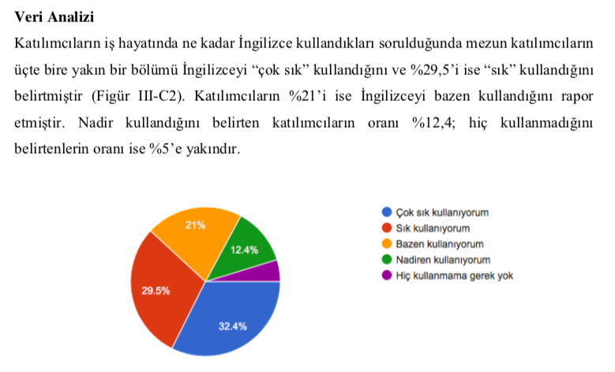
The results of the needs analysis survey carried out with graduates of YTU clearly show why you should care about English courses.

Slide 3
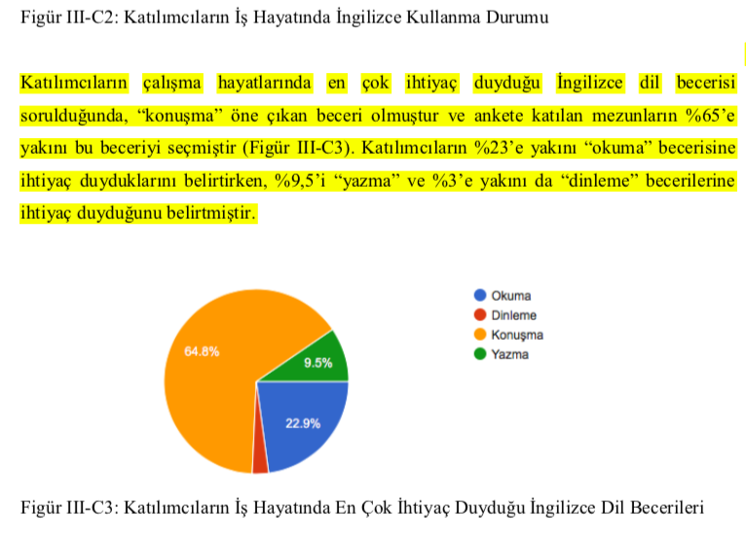
The most frequently needed language skill is speaking. It is followed by reading and writing.
The curriculum and courses of the Department of Modern Languages have been redesigned so as to be in line with the needs of both the undergraduate and graduate students.
The new approach aims to cover four language skills in all the courses with specific focus on reading & writing in Advanced English 1 & 2 and on speaking & listening & reading in Reading and Speaking in English.

Slide 4
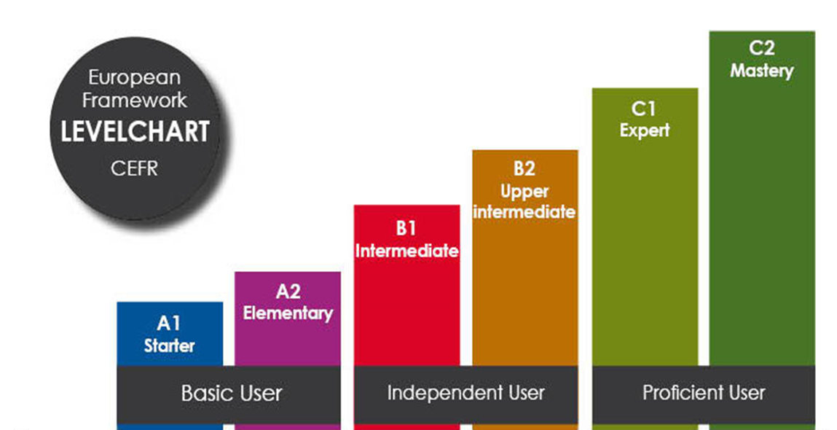
Levels in DML Fall courses: A2 & B2
MDB1031 ADVANCED ENGLISH 1 & MDB2051 READING AND SPEAKING IN ENGLISH
MDB1051/MDB1091 ENGLISH I

Slide 5
Course Information for MDB1031 Advanced English 1

Slide 6
Course Description
MDB1031 Advanced English 1 is a 3-credit compulsory course for the students of departments in which 30% or 100% of the coursework is in English.
The students who completed their preparatory classes or who have been successful in the exemption test can take up Advanced English I.
Advanced English I is not a prerequisite for Advanced English II. However, it should be kept in mind that these two courses are designed to improve language skills in a constructive trend; that is, Advanced English II is like a follow-up to Advanced English I. Therefore, it would be wise for students to take-up these courses respectively.
Priorities in the design of Advanced English I course includes a particular attention to the continuity between the prep classes, Advanced English courses, and the undergraduate English lectures; an emphasis on interdependency among four language skills, and a focus on reading and writing supported by speaking and listening in a constructive way.

Slide 7
The reading component
supporting the students’ exposure to a specified range of text complexity and text types across a wide range of disciplines aligned to college and career readiness
putting an emphasis on source analysis (reading, analyzing, and using reasoning to comprehend academic texts)
reinforcing an understanding of relevant Academic Word List words in context and how word choice helps shape meaning and tone
analyzing texts rhetorically; and synthesizing across topically related passages

Slide 8
Regarding the reading skill, Advanced English I course reinforces the students’ ability to
use different reading strategies,
comprehend factual information,
identify main idea and supporting details,
read analytically,
infer information from the passage,
recognize the main patterns of a text and the relationships among facts and ideas in different parts of a passage,
understand the author’s purpose,
understand vocabulary in context.

Slide 9
The writing component
facilitating students’ ability to comprehend appropriately chosen source texts to craft an effective analysis
encouraging students to write a purposeful and organized essay by analyzing and synthesizing information given in written, oral or audio-visual materials in a way that fosters analytical thinking and creativity

Slide 10
Regarding the writing skill, Advanced English I course reinforces the students’ ability to
analyze information given in a text or an audio-visual material
construct a summary of the important points in the texts,
explain how the main points relate to each other,
write an organized essay via analysis and synthesis of the key information presented.

Slide 11
Attendance
70% attendance is required in DML courses.
Students have to attend 70% of the total course hours (including health reports) even if they repeat compulsory English courses.
Approved health reports from an official or a health institution are included in the right to 30% excuses (absences), which means that these reports are not reduced from 70% required attendance. Health reports taken for absenteeism are not accepted.
3-credit courses have a total of 12 hours of absence. Students who exceed this limit fail the course with the grade “F0”.
The students have to take the course in whichever group they have chosen. Instructors cannot allow students to attend classes or take examinations in a group other than their own groups where they are already officially registered.
No matter what students’ level of language is, instructors cannot permit them not to attend the course for that reason by taking the initiative. All students have to attend the course regardless of their level.
The exam week applied in some departments at faculties is not valid for English courses. Even if a department has an exam week, the English courses in the DML will continue, attendance will be taken, and the classrooms of these courses will not be used by the related department for the exam.

Slide 12
Please remember!
Academic misconduct like plagiarism and cheating are punishable according to YTU SFL Student Disciplinary Action Regulations and Disciplinary Action Regulation for Students at Higher Education Institutions.
Always use copyrighted materials because using pirate materials is a crime punishable by the Law No. 5846 on Intellectual and Artistic Works.

Slide 13
Coursebook & Suggested Materials
LEAP 3 (New Edition)
Reading and Writing
(Pearson)
Book + eText + My eLab
SUGGESTED MATERIALS & SOURCES
will be uploaded to and frequently updated on
ybd.yildiz.edu.tr (Modern Diller – Öğrenci)
Davutpaşa: SFL building
Yıldız campus: Yeni Teknik Kırtasiye

Slide 14
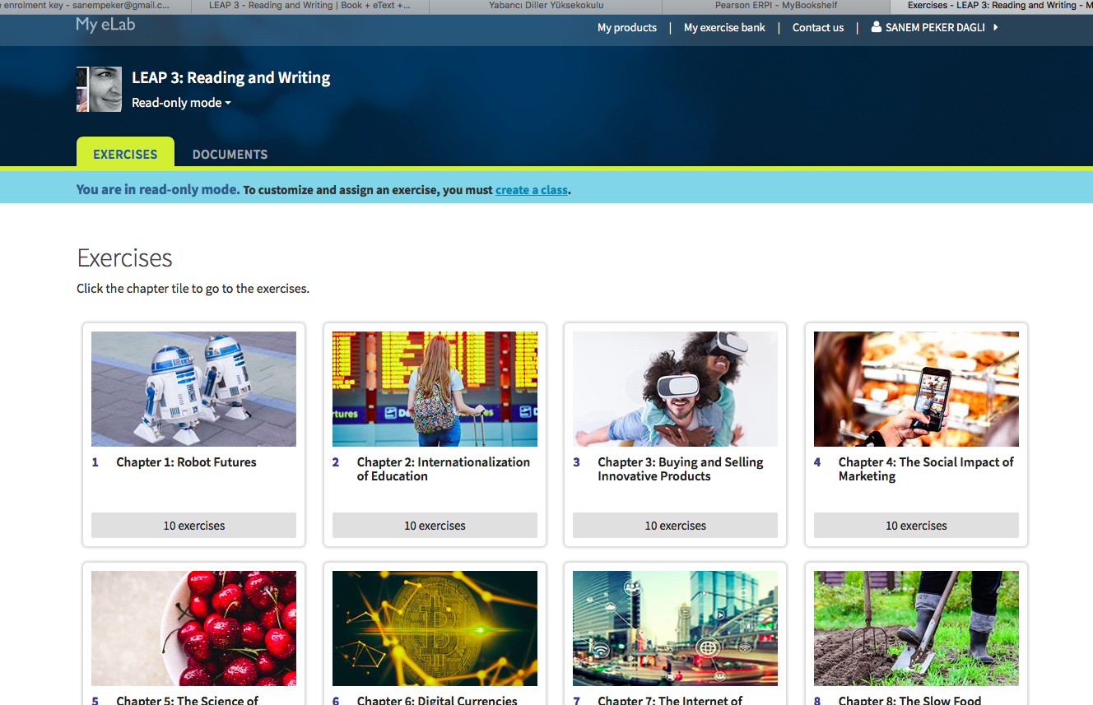
Online Learning Platform for Leap 3

Slide 15
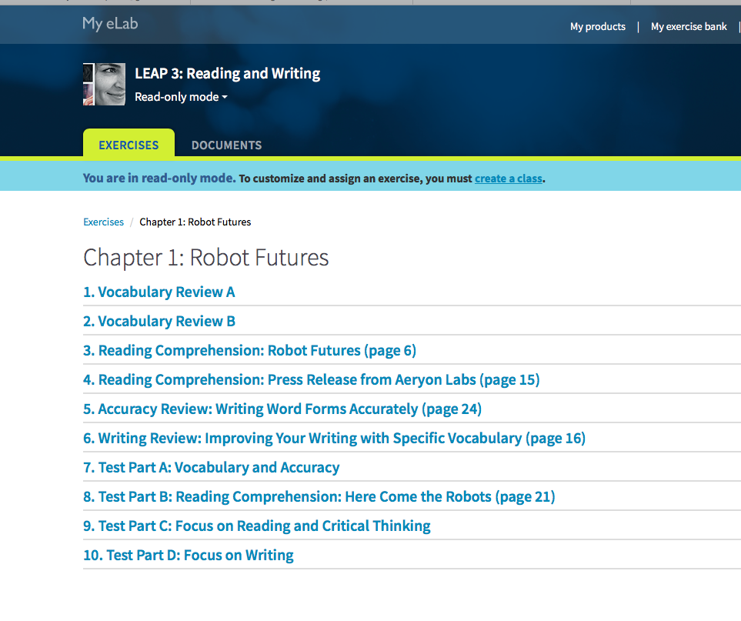
Using the Online Learning System of your book is a great help for you to revise what you have learned at school and improve your language skills day by day.

Slide 16
Assessment
ASSESSMENT
 | DATE | PERCENTAGE
QUIZ 1 (Paper-based, in class hours) | 22-26 OCTOBER | 15
QUIZ 2 (Paper-based, in class hours) | 3-7 DECEMBER | 15
MIDTERM EXAM (Paper-based, common) | 19-23 NOVEMBER | 30
FINAL EXAM (Paper-based, common) | 31 DECEMBER-4 JANUARY | 40
 | TOTAL | 100%

Slide 17
Make-up Exams
Students officially documenting their excuses (medical report, etc.) can take the make-up exams in the last week of the semester.
Students must submit the documents to their own departments, and, if the department accepts their validity, their names are given to the Head of the Department of Modern Languages. If the official letter is not delivered from their Department, the students’ exam grade is cancelled even if s/he has taken a make-up exam.
There are 2 in-class quizzes and 1 midterm in this course. The students who miss more than one exam can only take 1 make-up.
The make-up exam for the quizzes will cover the topics of both the first and the second quiz.
The make-up exam for the midterm will cover all the topics handled throughout the term.

Slide 18
GRADING SCALE
GRADE | LETTER | ECTS
90-100 | AA | 4.00
80-89 | BA | 3.50
70-79 | BB | 3.00
60-69 | CB | 2.50
53-59 | CC | 2.00
48-52 | DC | 1.50
40-47 | DD | 1.00
30-39 | FD | 0.50
0-29 | FF | 0.00
ABSENTEE | F0 | 0.00

Slide 19
Course Information for MDB1131 Advanced English 1 Only for BÖTE Students

Slide 20
Course Description
MDB1031 Advanced English 1 is a 2-credit compulsory course for the students of BÖTE department.
Advanced English I is not a prerequisite for Advanced English II. However, it should be kept in mind that these two courses are designed to improve language skills in a constructive trend; that is, Advanced English II is like a follow-up to Advanced English I. Therefore, it would be wise for students to take-up these courses respectively.
Priorities in the design of Advanced English I course includes a particular attention to the continuity between the prep classes, Advanced English courses, and the undergraduate English lectures; an emphasis on interdependency among four language skills, and a focus on reading and writing supported by speaking and listening in a constructive way.

Slide 21
The reading component
supporting the students’ exposure to a specified range of text complexity and text types across a wide range of disciplines aligned to college and career readiness
putting an emphasis on source analysis (reading, analyzing, and using reasoning to comprehend academic texts)
reinforcing an understanding of relevant Academic Word List words in context and how word choice helps shape meaning and tone
analyzing texts rhetorically; and synthesizing across topically related passages

Slide 22
Regarding the reading skill, Advanced English I course reinforces the students’ ability to
use different reading strategies,
comprehend factual information,
identify main idea and supporting details,
read analytically,
infer information from the passage,
recognize the main patterns of a text and the relationships among facts and ideas in different parts of a passage,
understand the author’s purpose,
understand vocabulary in context.

Slide 23
The writing component
facilitating students’ ability to comprehend appropriately chosen source texts to craft an effective analysis
encouraging students to write a purposeful and organized essay by analyzing and synthesizing information given in written, oral or audio-visual materials in a way that fosters analytical thinking and creativity

Slide 24
Regarding the writing skill, Advanced English I course reinforces the students’ ability to
analyze information given in a text or an audio-visual material
construct a summary of the important points in the texts,
explain how the main points relate to each other,
write an organized essay via analysis and synthesis of the key information presented.

Slide 25
Attendance
70% attendance is required in DML courses.
Students have to attend 70% of the total course hours (including health reports) even if they repeat compulsory English courses.
Approved health reports from an official or a health institution are included in the right to 30% excuses (absences), which means that these reports are not reduced from 70% required attendance. Health reports taken for absenteeism are not accepted.
2-credit courses have a total of 8 hours of absence. Students who exceed this limit fail the course with the grade “F0”.
The students have to take the course in whichever group they have chosen. Instructors cannot allow students to attend classes or take examinations in a group other than their own groups where they are already officially registered.
No matter what students’ level of language is, instructors cannot permit them not to attend the course for that reason by taking the initiative. All students have to attend the course regardless of their level.
The exam week applied in some departments at faculties is not valid for English courses. Even if a department has an exam week, the English courses in the DML will continue, attendance will be taken, and the classrooms of these courses will not be used by the related department for the exam.

Slide 26
Please remember!
Academic misconduct like plagiarism and cheating are punishable according to YTU SFL Student Disciplinary Action Regulations and Disciplinary Action Regulation for Students at Higher Education Institutions.
Always use copyrighted materials because using pirate materials is a crime punishable by the Law No. 5846 on Intellectual and Artistic Works.

Slide 27
Coursebook & Suggested Materials
LEAP 3 (New Edition)
Reading and Writing
(Pearson)
Book + eText + My eLab
SUGGESTED MATERIALS & SOURCES
will be uploaded to and frequently updated on
ybd.yildiz.edu.tr (Modern Diller – Öğrenci)
Davutpaşa: SFL building
Yıldız campus: Yeni Teknik Kırtasiye

Slide 28
Online Learning Platform for Leap 3

Slide 29
Using the Online Learning System of your book is a great help for you to revise what you have learned at school and improve your language skills day by day.

Slide 30
Assessment
ASSESSMENT
 | DATE | PERCENTAGE
MIDTERM 1 (Paper-based, common) | 19-23 NOVEMBER | 30
MIDTERM 2 (Paper-based, in class-hours) | 10-14 DECEMBER | 30
FINAL EXAM (Paper-based, common) | 31 DECEMBER-4 JANUARY | 40
 | TOTAL | 100%

Slide 31
Make-up Exams
Students officially documenting their excuses (medical report, etc.) can take the make-up exams in the last week of the semester.
Students must submit the documents to their own departments, and, if the department accepts their validity, their names are given to the Head of the Department of Modern Languages. If the official letter is not delivered from their Department, the students’ exam grade is cancelled even if s/he has taken a make-up exam.
There are 2 paper-based midterms in this course. The students who miss both of the exams can only take 1 make-up.
The make-up exam for the midterms will cover all the topics handled throughout the term.

Slide 32
GRADING SCALE
GRADE | LETTER | ECTS
90-100 | AA | 4.00
80-89 | BA | 3.50
70-79 | BB | 3.00
60-69 | CB | 2.50
53-59 | CC | 2.00
48-52 | DC | 1.50
40-47 | DD | 1.00
30-39 | FD | 0.50
0-29 | FF | 0.00
ABSENTEE | F0 | 0.00

Slide 33
Course Information for MDB2051 Reading and Speaking in English

Slide 34
Course Description
This is an upper-intermediate 2-credit social elective course for the students of departments in which 30% or 100% of the coursework is in English. The students who completed their preparatory classes or who have been successful in the exemption test can take up Reading and Speaking in English course. Advanced English I and/or Advanced English II are not a prerequisite for this course. However, it should be kept in mind that this course is designed to improve language skills in a constructive trend focusing on oral language skills. Therefore, it would be wise for students to take-up Advanced English I, Advanced English II, and Reading and Speaking in English respectively.
Priorities in the design of Reading and Speaking in English course include a particular attention to help students express themselves orally in academic and daily life situations, an emphasis on interdependency among four language skills, and a focus on reading and speaking supported by listening and writing skills in a constructive way. The speaking strategies and tasks are designed in line with the internationally recognized language tests like TOEFL, IELTS, and PTE.

Slide 35
The reading component
supporting the students’ exposure to a specified range of text complexity and text types across a wide range of disciplines aligned to college and career readiness
putting an emphasis on source analysis (reading, analyzing, and using reasoning to comprehend academic texts)
reinforcing an understanding of relevant Academic Word List words in context and how word choice helps shape meaning and tone
analyzing texts rhetorically; and synthesizing across topically related passages

Slide 36
Regarding the reading, listening, and writing skills, Reading and Speaking in English course reinforces the students’ ability to
comprehend information in written and audio-visual materials,
read/listen to recognize the main patterns and the relationships among facts and ideas in different parts of a text,
understand the author’s/speaker’s purpose,
understand vocabulary in context,
take notes while reading/listening,
compose an outline/a summary of the written/audio-visual material at hand,
read/listen analytically,
infer information from the text, and read/listen to respond orally.

Slide 37
The speaking component
facilitating students’ ability to comprehend an appropriately chosen source text, to craft an effective analysis and create an oral response
encouraging students to compose a purposeful and organized oral response to the given written, oral or audio-visual materials in a way that fosters analytical thinking and creativity

Slide 38
Speaking skills aimed to be improved:
extending short answers (IELTS)
talking briefly about a personal experience (TOEFL)
expressing opinions based on preference (TOEFL)
analyzing information and composing a summary from the key points of a text in order to talk about facts and report other people’s opinions (TOEFL)
describing images (maps/charts/graphs) (PTE)
generating ideas and expressing personal opinions
generating arguments and/or counter arguments and taking part in a debate

Slide 39
Attendance
70% attendance is required in DML courses.
Students have to attend 70% of the total course hours (including health reports) even if they repeat compulsory English courses.
Approved health reports from an official or a health institution are included in the right to 30% excuses (absences), which means that these reports are not reduced from 70% required attendance. Health reports taken for absenteeism are not accepted.
2-credit courses have a total of 8 hours of absence. Students who exceed this limit fail the course with the grade “F0”.
The students have to take the course in whichever group they have chosen. Instructors cannot allow students to attend classes or take examinations in a group other than their own groups where they are already officially registered.
No matter what students’ level of language is, instructors cannot permit them not to attend the course for that reason by taking the initiative. All students have to attend the course regardless of their level.
The exam week applied in some departments at faculties is not valid for English courses. Even if a department has an exam week, the English courses in the DML will continue, attendance will be taken, and the classrooms of these courses will not be used by the related department for the exam.

Slide 40
Please remember!
Academic misconduct like plagiarism and cheating are punishable according to YTU SFL Student Disciplinary Action Regulations and Disciplinary Action Regulation for Students at Higher Education Institutions.

Slide 41
Coursebook & Suggested Materials
MDB2051 Course Material
prepared by
Department of Modern Languages
SUGGESTED MATERIALS & SOURCES
will be uploaded to and frequently updated on
ybd.yildiz.edu.tr (Modern Diller – Öğrenci)
Davutpaşa: SFL building photocopy center (Floor -1)
Yıldız campus: Yeni Teknik Kırtasiye

Slide 42
Assessment
ASSESSMENT
 | DATE | PERCENTAGE
MIDTERM EXAM (Paper-based, common) | 19-23 NOVEMBER | 30
ORAL EXAM (In class-hours) | 3-7 DECEMBER 10-14 DECEMBER 17-21 DECEMBER | 30
FINAL EXAM (Paper-based, common) | 31 DECEMBER-4 JANUARY | 40
 | TOTAL | 100%

Slide 43
Oral Exam

Slide 44
Make-up Exams
Students officially documenting their excuses (medical report, etc.) can take the make-up exams in the last week of the semester.
Students must submit the documents to their own departments, and, if the department accepts their validity, their names are given to the Head of the Department of Modern Languages. If the official letter is not delivered from their Department, the students’ exam grade is cancelled even if s/he has taken a make-up exam.
The make-up exam for the paper-based midterm will cover all the topics handled throughout the term.
The students have to bring a medical report for the oral exam to be able to take it in the following week(s).

Slide 45
GRADING SCALE
GRADE | LETTER | ECTS
90-100 | AA | 4.00
80-89 | BA | 3.50
70-79 | BB | 3.00
60-69 | CB | 2.50
53-59 | CC | 2.00
48-52 | DC | 1.50
40-47 | DD | 1.00
30-39 | FD | 0.50
0-29 | FF | 0.00
ABSENTEE | F0 | 0.00

Slide 46
Course Information for MDB1051 English 1

Slide 47
Course Description
This basic English course is a 3-credit compulsory course for the students of departments in which 100% of the coursework is in Turkish. English I is not a prerequisite for English II. However, it should be kept in mind that these two courses are designed to improve language skills in a constructive trend; that is, English II is like a follow-up to English I. Therefore, it would be wise for students to take-up these courses respectively.
MDB1051 English I is delivered in two different modes: face-to-face and online with no specific difference between contents and assessment systems. For the students who take up the courses in face-to-face mode, attendance is compulsory by 70%. There is no attendance requirement for the students who take up the courses online. To be able to register for the online courses, the students need to pay a certain amount of fee.

Slide 48
Course Description
English I and II courses are designed to improve the students’ communication skills necessary in daily life situations encompassing listening and speaking at elementary level.
The students who take up these courses will be equipped with the necessary grammatical structures (the present progressive tense, present simple tense, future tense, and simple past tense, Wh- questions, modals, adjectives of comparison, adverbs of frequency, the future tense, simple past tense, present perfect tense, modals, comparatives and superlatives, linking words) with the aim of improving four basic language skills.
The students will also be able to read different reading texts and produce written texts (e-mails, self-introduction, posters and forms, recipes).

Slide 49
Attendance
70% attendance is required in DML face-to-face courses.
Students have to attend 70% of the total course hours (including health reports) even if they repeat compulsory English courses.
Approved health reports from an official or a health institution are included in the right to 30% excuses (absences), which means that these reports are not reduced from 70% required attendance. Health reports taken for absenteeism are not accepted.
3-credit courses have a total of 12 hours of absence. Students who exceed this limit fail the course with the grade “F0”.
The students have to take the course in whichever group they have chosen. Instructors cannot allow students to attend classes or take examinations in a group other than their own groups where they are already officially registered.
No matter what students’ level of language is, instructors cannot permit them not to attend the course for that reason by taking the initiative. All students have to attend the course regardless of their level.
The exam week applied in some departments at faculties is not valid for English courses. Even if a department has an exam week, the English courses in the DML will continue, attendance will be taken, and the classrooms of these courses will not be used by the related department for the exam.

Slide 50
Please remember!
Academic misconduct like plagiarism and cheating are punishable according to YTU SFL Student Disciplinary Action Regulations and Disciplinary Action Regulation for Students at Higher Education Institutions.
Always use copyrighted materials because using pirate materials is a crime punishable by the Law No. 5846 on Intellectual and Artistic Works.

Slide 51
Coursebook & Suggested Materials
Pioneer (Elementary)
(MM Publications)
SUGGESTED MATERIALS & SOURCES
will be uploaded to and frequently updated on
ybd.yildiz.edu.tr (Modern Diller – Öğrenci)
Davutpaşa: SFL building

Slide 52
Assessment
ASSESSMENT
 | DATE | PERCENTAGE
MIDTERM 1 (Paper-based, common) | 19-23 NOVEMBER | 30
MIDTERM 2 (Paper-based, in class-hours) | 10-14 DECEMBER | 30
FINAL EXAM (Paper-based, common) | 31 DECEMBER-4 JANUARY | 40
 | TOTAL | 100%

Slide 53
Make-up Exams
Students officially documenting their excuses (medical report, etc.) can take the make-up exams in the last week of the semester.
Students must submit the documents to their own departments, and, if the department accepts their validity, their names are given to the Head of the Department of Modern Languages. If the official letter is not delivered from their Department, the students’ exam grade is cancelled even if s/he has taken a make-up exam.
There are 2 midterms in this course. The students who miss both of the exams can only take 1 make-up.
The make-up exam for the midterms will cover all the topics handled throughout the term.

Slide 54
GRADING SCALE
GRADE | LETTER | ECTS
90-100 | AA | 4.00
80-89 | BA | 3.50
70-79 | BB | 3.00
60-69 | CB | 2.50
53-59 | CC | 2.00
48-52 | DC | 1.50
40-47 | DD | 1.00
30-39 | FD | 0.50
0-29 | FF | 0.00
ABSENTEE | F0 | 0.00

Slide 55
Course Information for MDB1091 English 1 (Only for the students of Faculty of Education)

Slide 56
Course Description
This basic English course is a 2-credit compulsory course for the students of Faculty of Education in which 100% of the coursework is in Turkish. English I is not a prerequisite for English II. However, it should be kept in mind that these two courses are designed to improve language skills in a constructive trend; that is, English II is like a follow-up to English I. Therefore, it would be wise for students to take-up these courses respectively.
MDB1091 English I is delivered in two different modes: face-to-face and online with no specific difference between contents and assessment systems. For the students who take up the courses in face-to-face mode, attendance is compulsory by 70%. There is no attendance requirement for the students who take up the courses online. To be able to register for the online courses, the students need to pay a certain amount of fee.

Slide 57
Course Description
English I and II courses are designed to improve the students’ communication skills necessary in daily life situations encompassing listening and speaking at elementary level.
The students who take up these courses will be equipped with the necessary grammatical structures (the present progressive tense, present simple tense, future tense, and simple past tense, Wh- questions, modals, adjectives of comparison, adverbs of frequency, the future tense, simple past tense, present perfect tense, modals, comparatives and superlatives, linking words) with the aim of improving four basic language skills.
The students will also be able to read different reading texts and produce written texts (e-mails, self-introduction, posters and forms, recipes).

Slide 58
Attendance
70% attendance is required in DML face-to-face courses.
Students have to attend 70% of the total course hours (including health reports) even if they repeat compulsory English courses.
Approved health reports from an official or a health institution are included in the right to 30% excuses (absences), which means that these reports are not reduced from 70% required attendance. Health reports taken for absenteeism are not accepted.
2-credit courses have a total of 8 hours of absence. Students who exceed this limit fail the course with the grade “F0”.
The students have to take the course in whichever group they have chosen. Instructors cannot allow students to attend classes or take examinations in a group other than their own groups where they are already officially registered.
No matter what students’ level of language is, instructors cannot permit them not to attend the course for that reason by taking the initiative. All students have to attend the course regardless of their level.
The exam week applied in some departments at faculties is not valid for English courses. Even if a department has an exam week, the English courses in the DML will continue, attendance will be taken, and the classrooms of these courses will not be used by the related department for the exam.

Slide 59
Please remember!
Academic misconduct like plagiarism and cheating are punishable according to YTU SFL Student Disciplinary Action Regulations and Disciplinary Action Regulation for Students at Higher Education Institutions.
Always use copyrighted materials because using pirate materials is a crime punishable by the Law No. 5846 on Intellectual and Artistic Works.

Slide 60
Coursebook & Suggested Materials
Pioneer (Elementary)
(MM Publications)
SUGGESTED MATERIALS & SOURCES
will be uploaded to and frequently updated on
ybd.yildiz.edu.tr (Modern Diller – Öğrenci)
Davutpaşa: SFL building

Slide 61
Assessment
ASSESSMENT
 | DATE | PERCENTAGE
MIDTERM 1 (Paper-based, common) | 19-23 NOVEMBER | 30
MIDTERM 2 (Paper-based, in class-hours) | 10-14 DECEMBER | 30
FINAL EXAM (Paper-based, common) | 31 DECEMBER-4 JANUARY | 40
 | TOTAL | 100%

Slide 62
Make-up Exams
Students officially documenting their excuses (medical report, etc.) can take the make-up exams in the last week of the semester.
Students must submit the documents to their own departments, and, if the department accepts their validity, their names are given to the Head of the Department of Modern Languages. If the official letter is not delivered from their Department, the students’ exam grade is cancelled even if s/he has taken a make-up exam.
There are 2 midterms in this course. The students who miss both of the exams can only take 1 make-up.
The make-up exam for the midterms will cover all the topics handled throughout the term.

Slide 63
GRADING SCALE
GRADE | LETTER | ECTS
90-100 | AA | 4.00
80-89 | BA | 3.50
70-79 | BB | 3.00
60-69 | CB | 2.50
53-59 | CC | 2.00
48-52 | DC | 1.50
40-47 | DD | 1.00
30-39 | FD | 0.50
0-29 | FF | 0.00
ABSENTEE | F0 | 0.00

